Slide 1
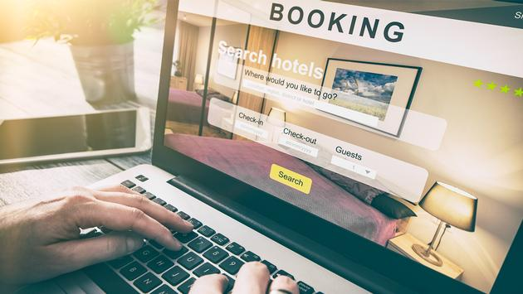
Hotel Rating Classification

Slide 2
Project-DS_P_147 NATURAL LANGUAGE PROCESSING
Mentors:
KARTHIK MUSKULA
DHANYAPRIYA SOMASUNDARAM
16-07-2022
Group 5:
Group Members:
PAYAL VISHAL KATHAR
PRIYANKA SUNIL MAHULE
KAVYA M P
NIDHIN KV

Slide 3
Objective:
This is a Classification Project, our goal is to examine how travellers are communicating their positive and negative experiences in online platforms for staying in a specific hotel and major objective is what are the attributes that travellers are considering while selecting a hotel.
With this manager can understand which elements of their hotel influence more in forming a positive review or improves hotel brand image.

Slide 4
Project Flow
Understanding The Business Objective
Data Collection
EDA
Modelling
Model Evaluation
Model Deployment

Slide 5
EXPLORATORY DATA ANALYSIS
Cleaning Data
Remove special characters using library re
Spell Check using library autocorrect
Expanding Contractions using library contractions
Removing Punctuations
Tokenization using library nltk
Converting Uppercase letters to Lowercase
Removing Stopwords using library nltk
Count Number of Words in single review
Number of characters in single review
Stemming
Lemmatization

Slide 6
Data Set Details:
Shape of the dataset is 20491 Rows ,2 Columns.
The two features are “Reviews” and “Ratings”.
Reviews Feature contain categorical values and it is a “object” Datatype.
Ratings Feature contain numerical values and it is a “float64” Datatype.
There are No null or missing values.
No outliers in data.

Slide 7


Slide 8
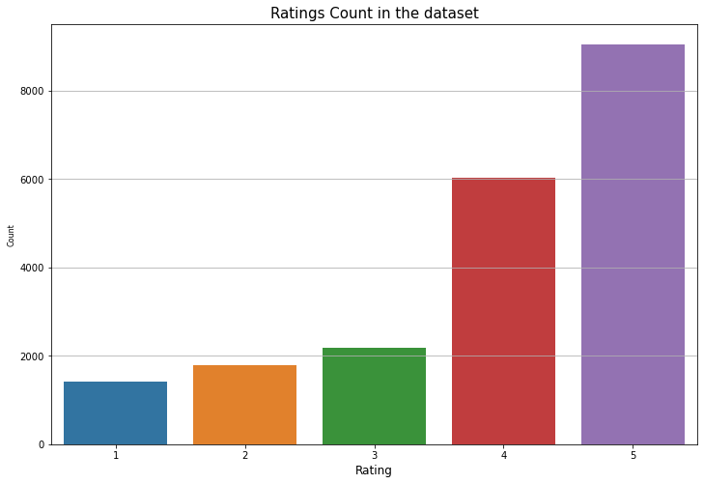
HISTOGRAM
Here it is found that the given Data Set have more reviews with Rating 5 as compared with the reviews with rest of the ratings.

Slide 9
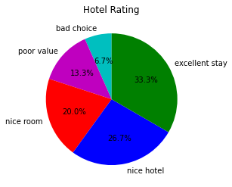
Pie Plot
By looking in to the plots plotted it is found that the major portion reviews in the Data Set are Good Reviews (i.e., 4 & 5).

Slide 10
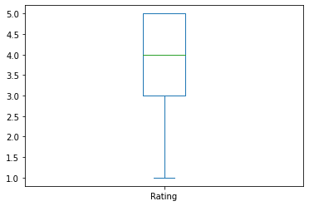
BOX PLOT
The Box Plot Shows there are no Outliers in the given Data Set and
It is Positively Skewed.

Slide 11
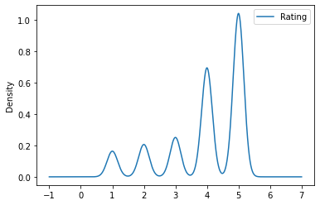
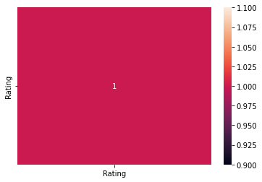
DENSITY PLOT AND HEAT MAP

Slide 12
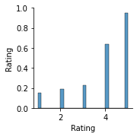
Pair Plot
Value Counts:
Rating_1 :- 1421 (7%)
Rating_2 :- 1793 (9%)
Rating_3 :- 2184 (11%)
Rating_4 :- 6039 (29%)
Rating_5 :- 9054 (44%)

Slide 13
TEXT PRE-PROCESSING
Text pre-processing is the most important step before further exploring a text data. It removes unwanted and unnecessary texts.
Cleaning the data by removing punctuations,Hashtags,RH,urls,tags from the data
Removing Stop words.
Reducing words to their root form through Lemmatization.
Finding Polarity and subjectivity of the words to understand the sentiment behind it

Slide 14
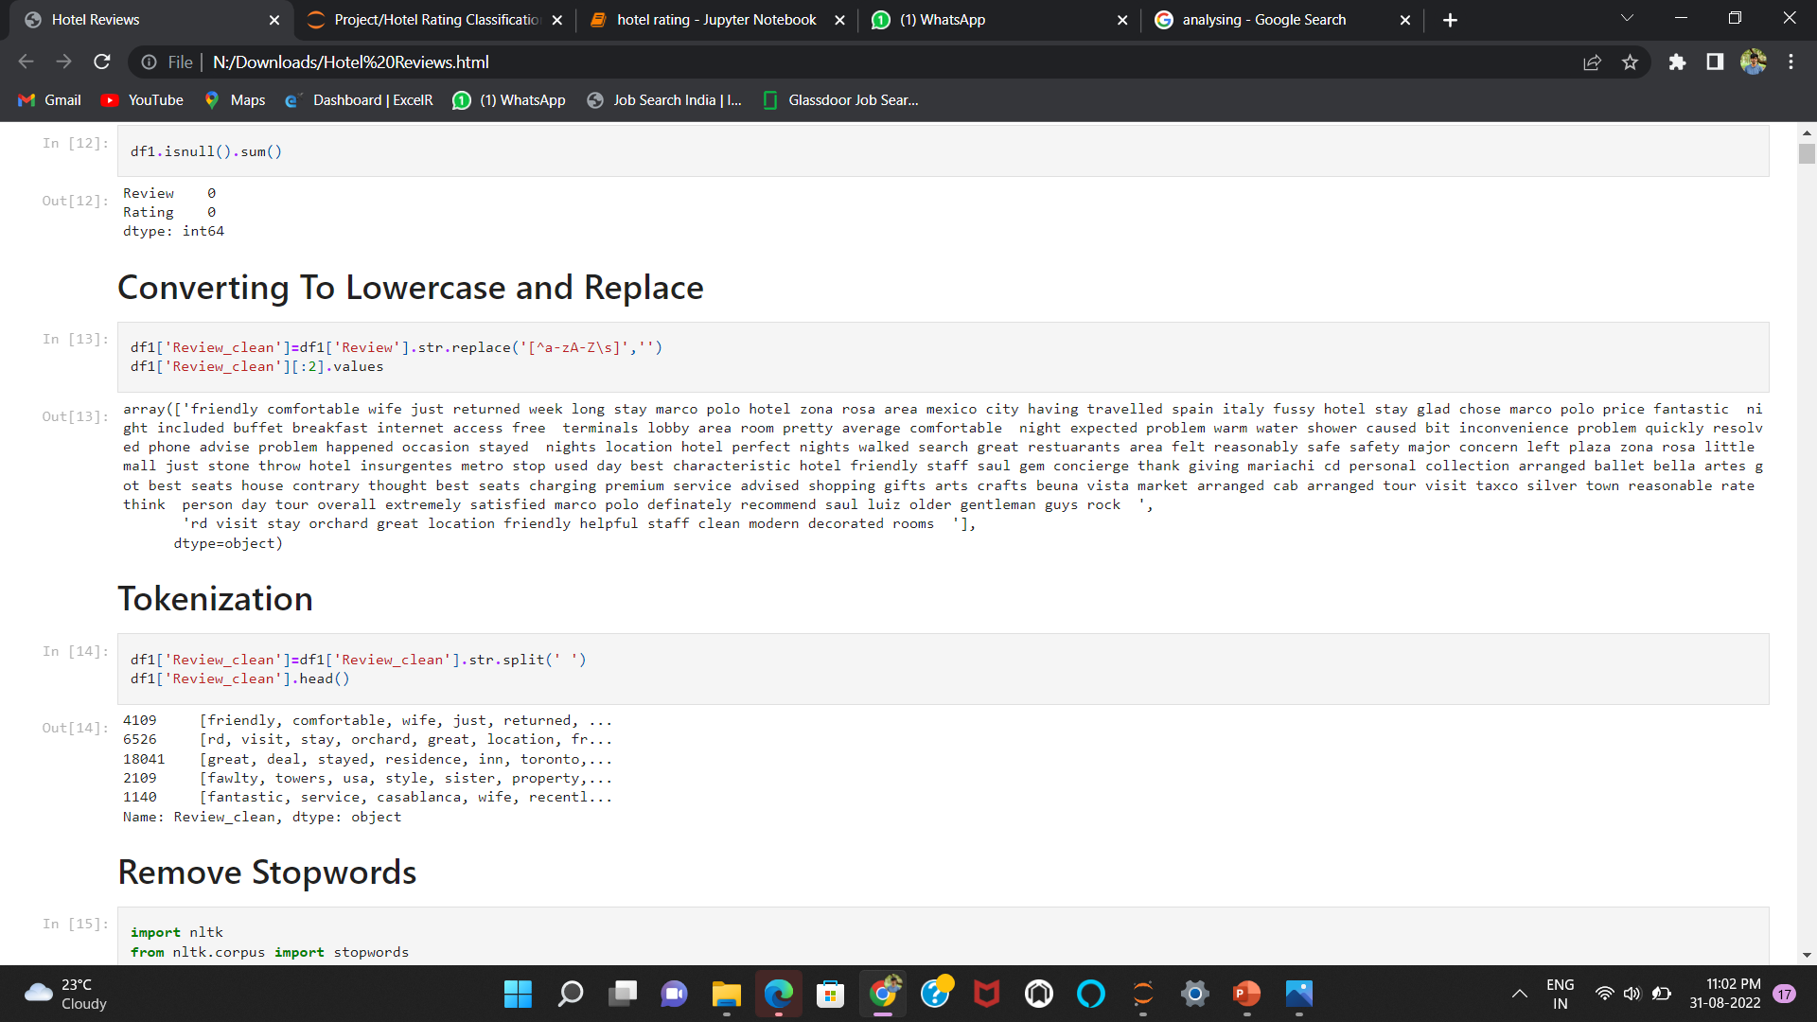
Converting the texts into lowercase
Converting all your data to lowercase helps in the process of preprocessing and in later stages in the NLP application, when doing parsing. If done every similar word can be driven into a single dimension.

Slide 15
Tokenization
Tokenization is used to split paragraphs and sentences into smaller units that can be more easily assigned meaning. Here word tokenization is done so the textual sentences are decomposed into individual words

Slide 16
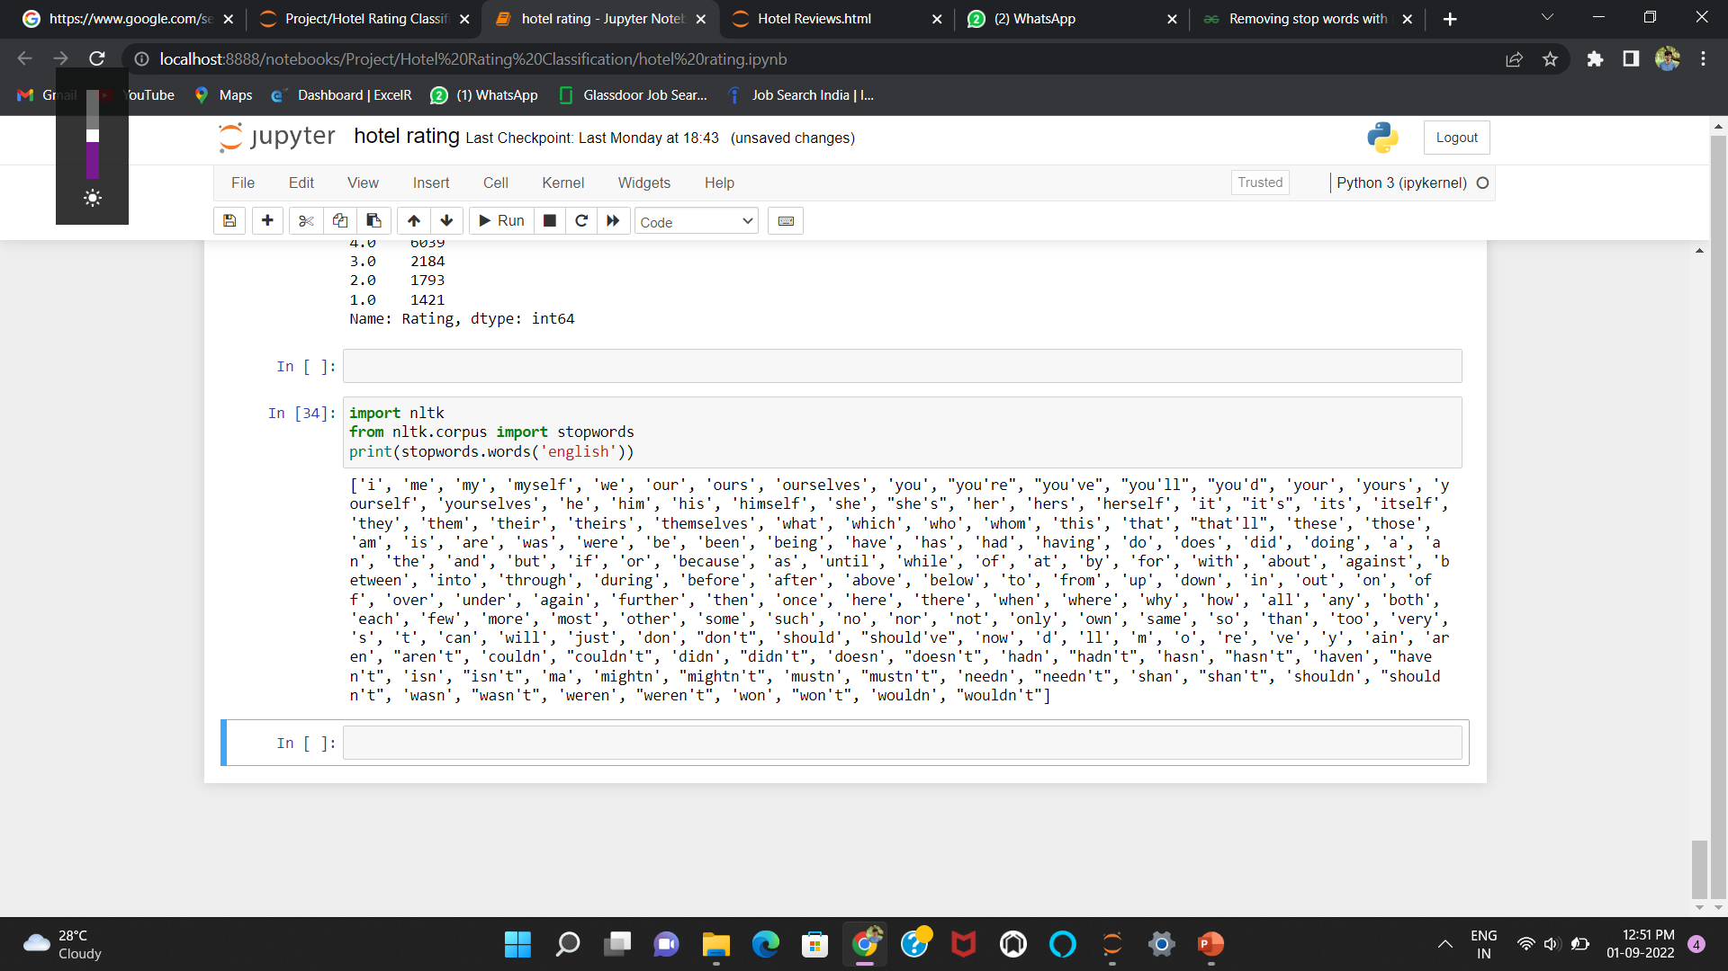
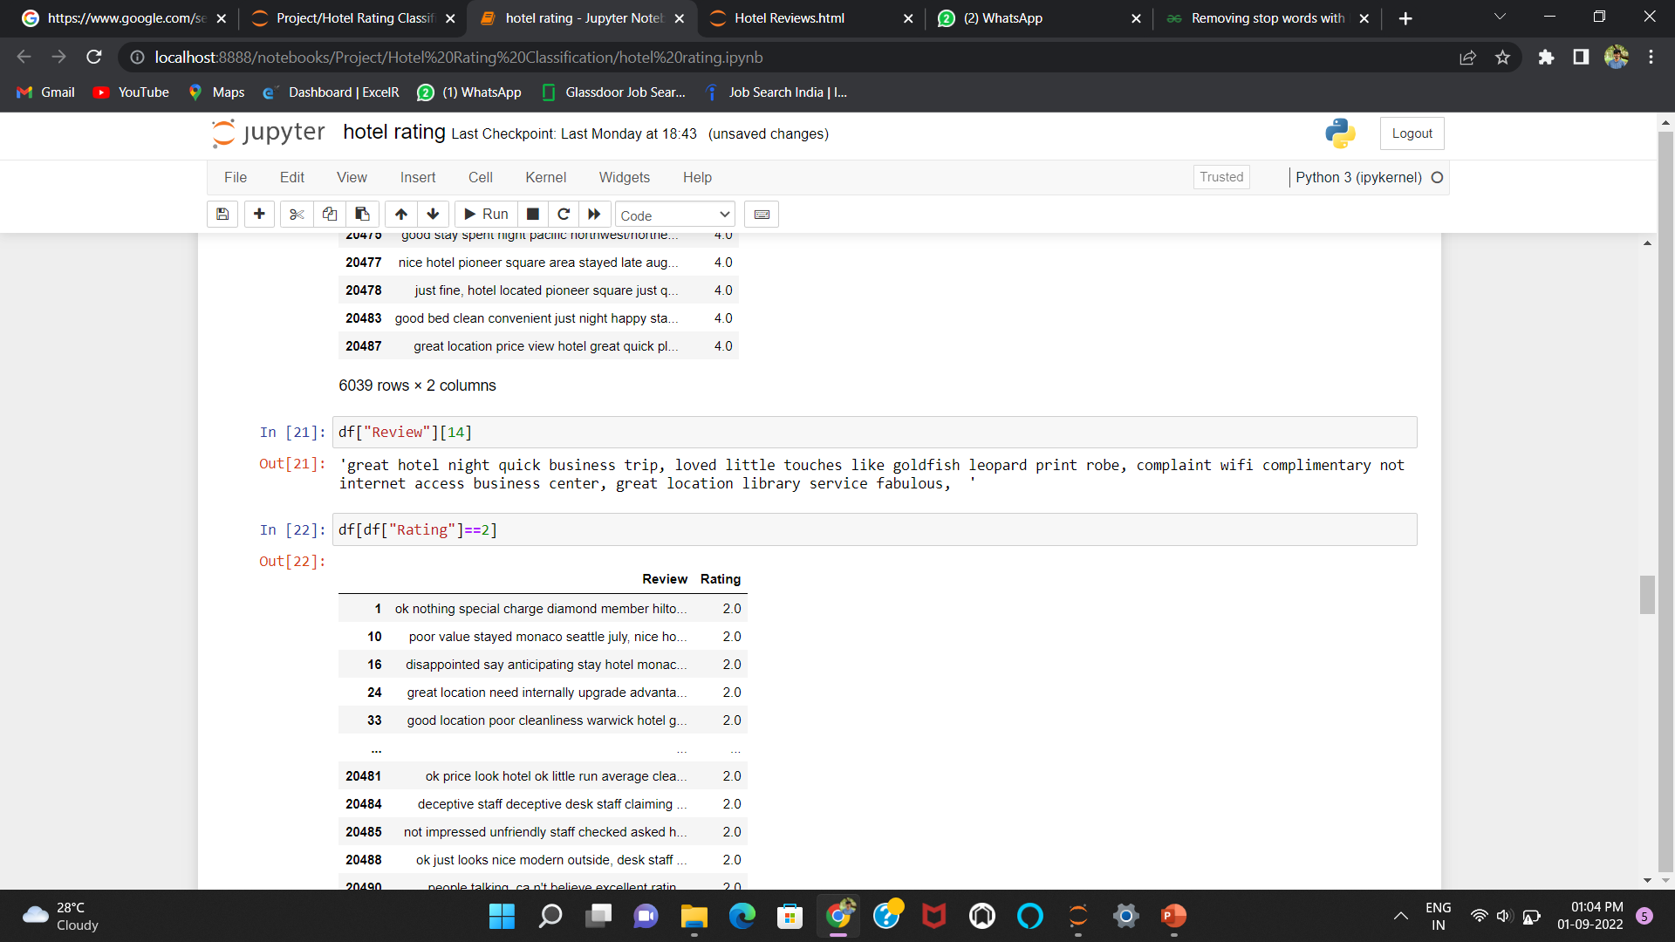
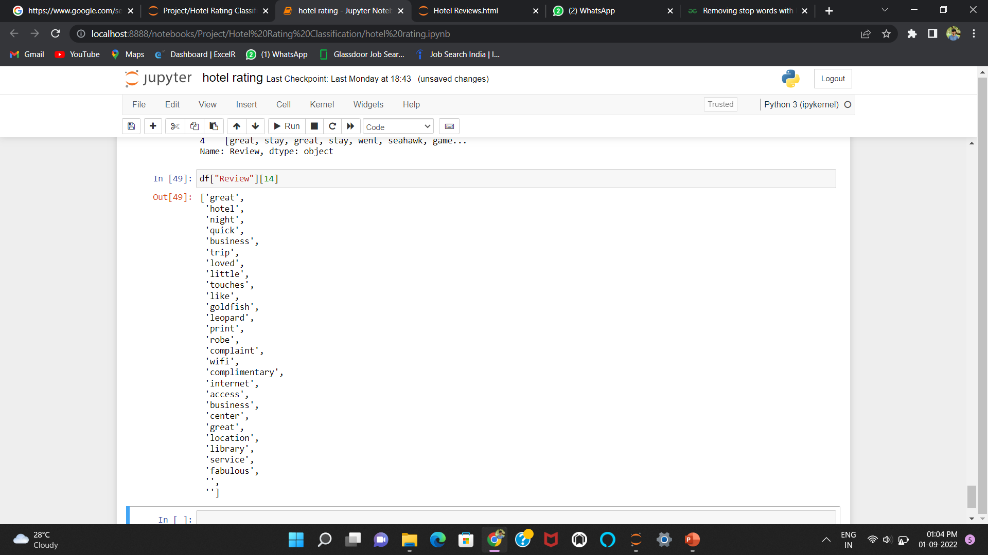
Removing Stop words
Stop word are the words that are generally used in language that provide textual format and not giving any important information, by removing these words, we remove the low-level information from our text in order to give more focus to the important information.
Before removing stop words
After removing stop words
Stop words

Slide 17
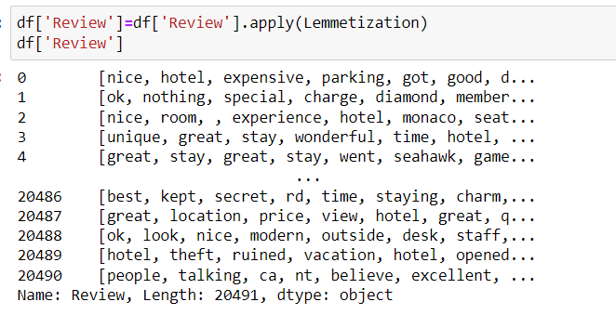
Lemmatization
Lemmatization is the process of converting a word to its base form. The obvious advantage of lemmatization is that it is more accurate. It is useful to get root words from the dictionary, as it recognizes words based on their exact and contextual meaning.

Slide 18
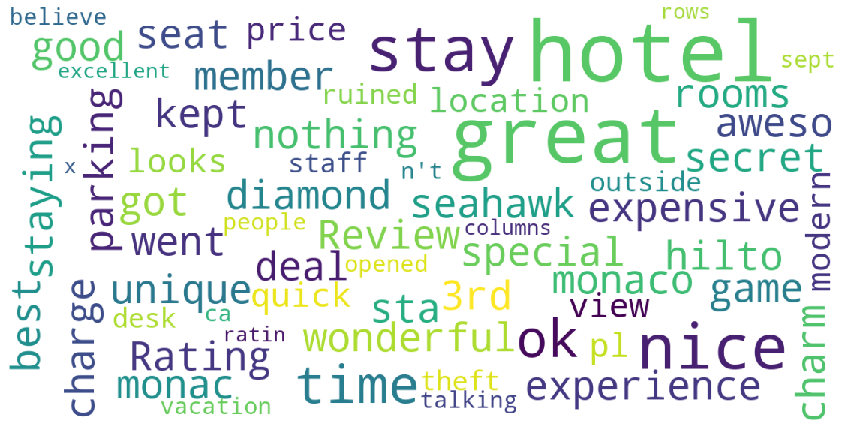
Word Cloud
Most of the words are indeed related to the customer experience with the hotel stay: great, nice, awesome, good, expensive etc.
Some words are related to the hotels: hotel, rooms, parking etc.

Slide 19
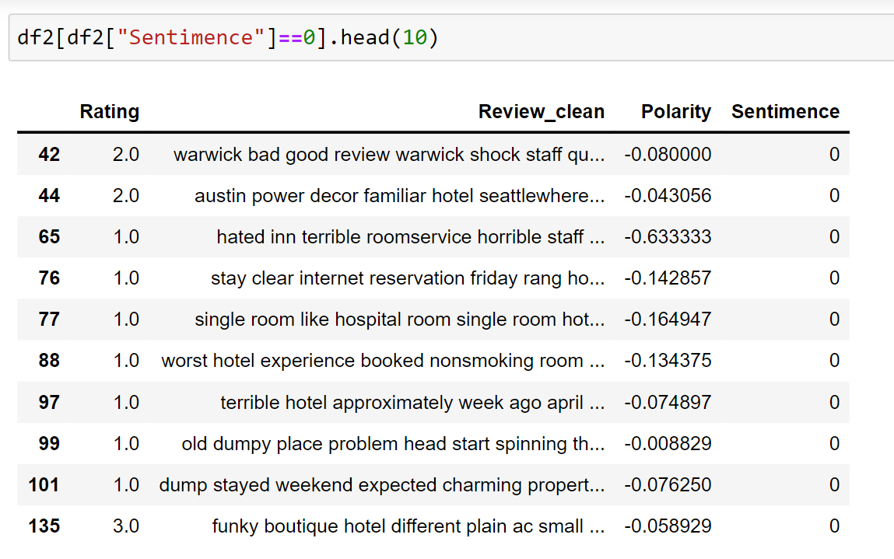
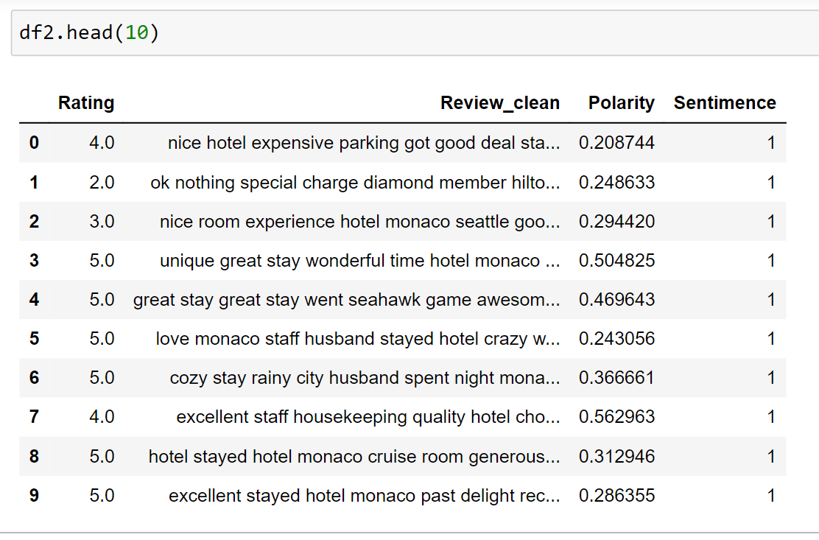
Sentimental analysis
The sentimental analysis was performed by TextBlob Library.
Using the TextBlob library the polarity score of each review was gathered and stored as a new feature. Later the reviews was categorised into Positive and Negative. Polarity greater than 0 was assigned as positive and lesser was assigned as negative reviews respectively.

Slide 20
n-gram analysis
Bigram rating counts for 4 and 5
For rating 4
[('great location', 845),
('staff friendly', 763),
('punta cana', 565),
('walking distance', 528),
('friendly helpful', 503),
('staff helpful', 416),
('good value', 414),
('stayed nights', 409),
('minute walk', 402),
('great time', 401)]
For rating 5
[('great location', 1014),
('staff friendly', 1013),
('friendly helpful', 777),
('highly recommend', 736),
('walking distance', 735),
('punta cana', 603),
('staff helpful', 540),
('place stay', 540),
('stayed nights', 511),
('minute walk', 511)]

Slide 21
Tri gram rating counts for 4 and 5
For rating 4
[('staff friendly helpful', 298),
('good value money', 125),
('10 minute walk', 99),
('great place stay', 98),
('flat screen tv', 89),
('easy walking distance', 85),
('la carte restaurants', 85),
('king size bed', 73),
('staff helpful friendly', 68),
('free internet access', 68)]
For rating 5
[('staff friendly helpful', 403),
('great place stay', 169),
('flat screen tv', 151),
('king size bed', 114),
('10 minute walk', 114),
('staff helpful friendly', 104),
('great location great', 100),
('free internet access', 100),
('easy walking distance', 96),
('staff extremely helpful', 94)]

Slide 22
Check for common words in highest rated reviews
{'great location',
'punta cana',
'staff friendly',
'stayed nights',
'walking distance’}
Check for common words in least rated reviews
{'punta cana', 'san juan'}

Slide 23
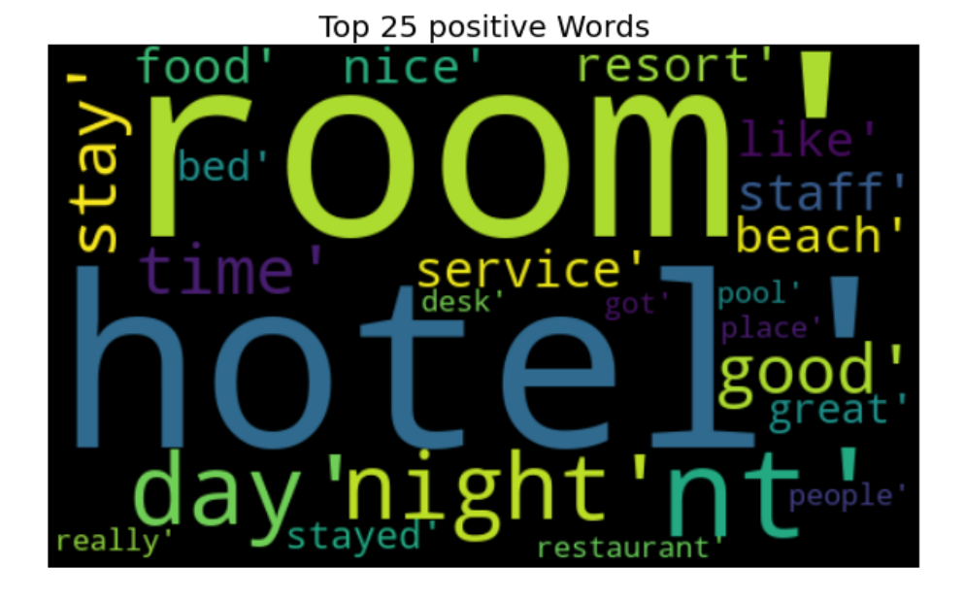
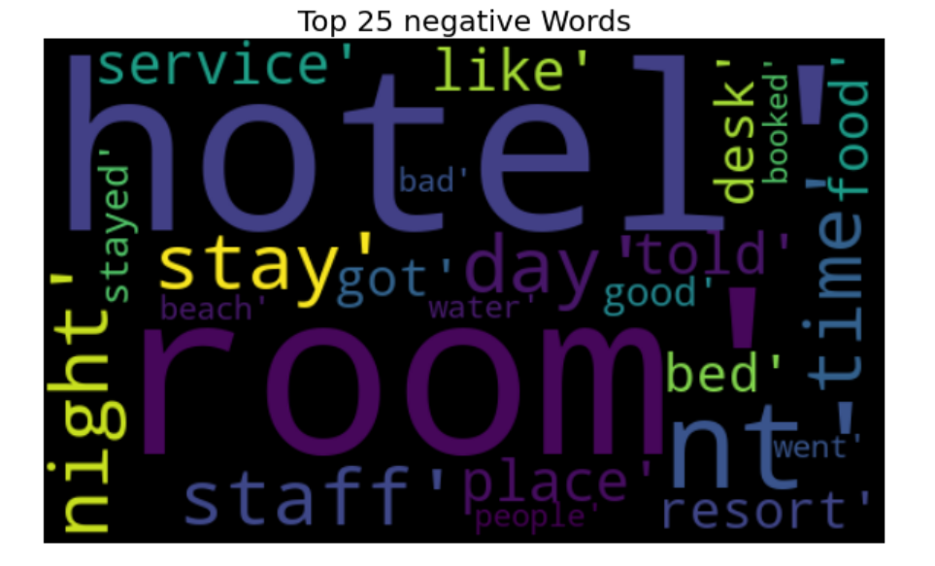
Wordcloud for positive reviews
Wordcloud for Negative reviews

Slide 24
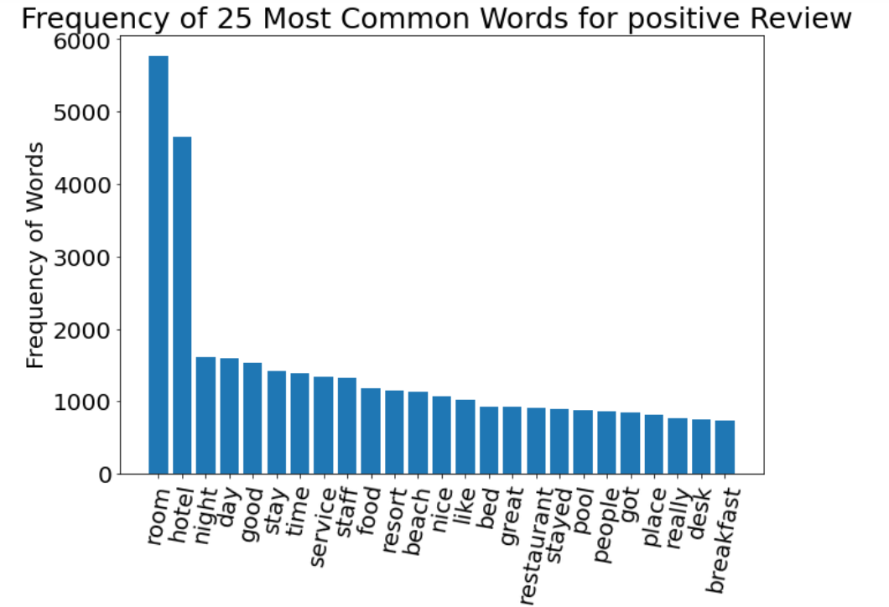
Frequency of 25 Most Common Words for positive Review

Slide 25
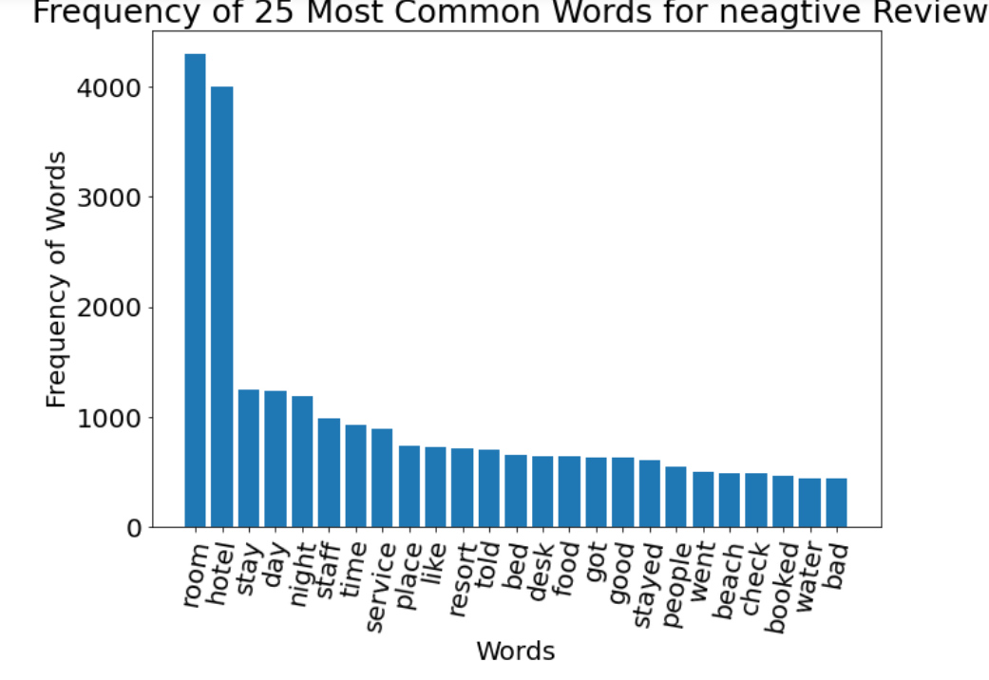
Frequency of 25 Most Common Words for Neagtive Review

Slide 26
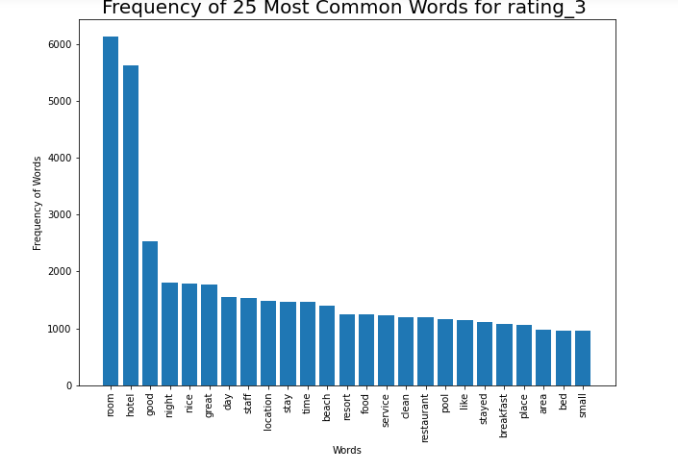
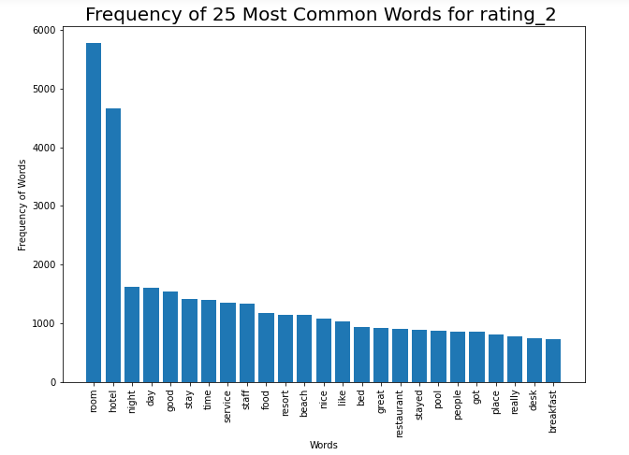
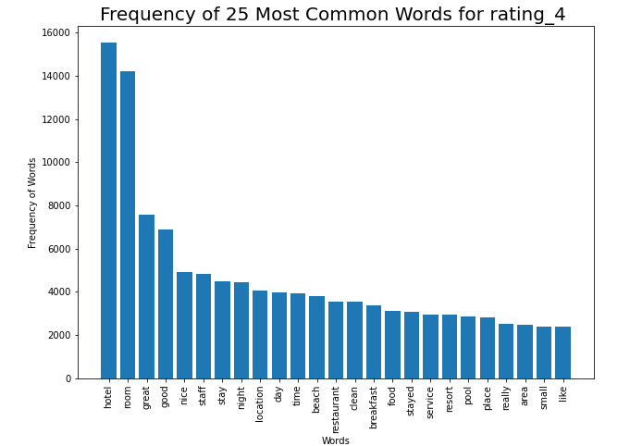
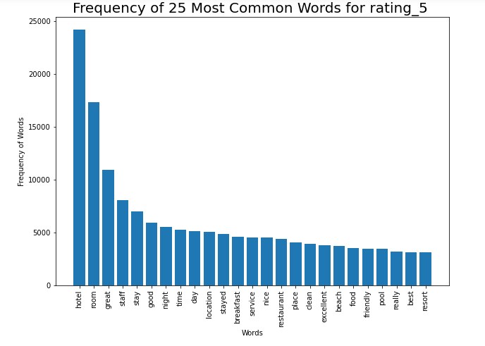

Slide 27
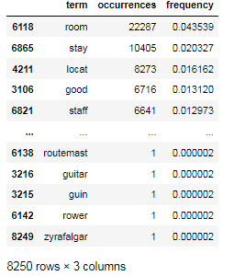
FEATURE EXTRACTION
Applied the Feature Extraction technique Count Vectorization. It is showing the words with most and least occurrences and their frequencies.
It helps us in dealing with most frequent words.

Slide 28
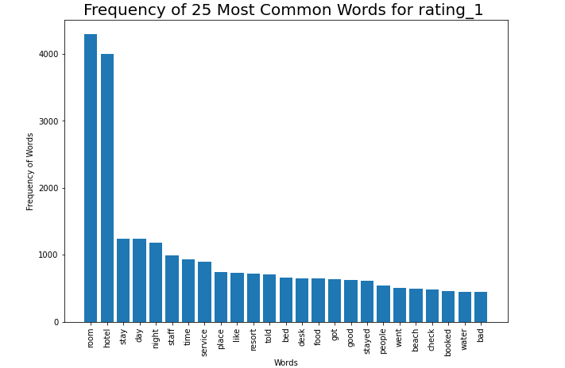
Frequency of 25 Most Common Words
These are the top 25 words in reviews and their frequency.
The word “room” is used more than 22000 times in the reviews.

Slide 29
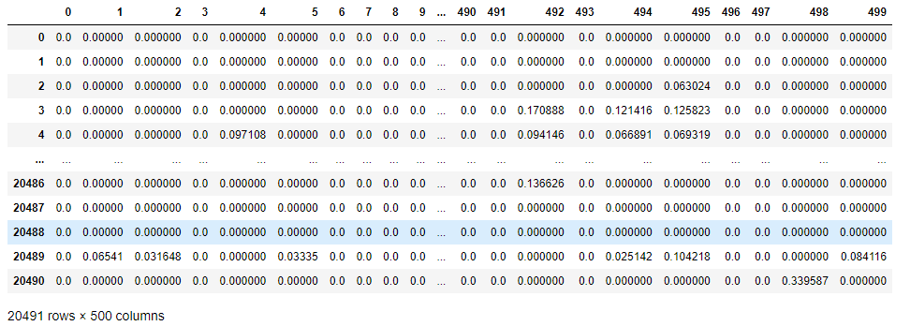
Another Feature Extraction technique TFIDF( term frequency–inverse document frequency). It is showing the weights of term's frequency (TF) and its inverse document frequency (IDF).
By TFIDF we can know how relevant a term is in a given document.
Using this TFIDF we can get better accuracy while building

Slide 30
MODEL BUILDING
Logistic Regression
Random Forest Classifier
Multinomial Naivebayes
Gradient Boosting Classifier
support vector machine (SVM)
DecissionTree
K Neighbors Classifier
AdaBoost Classifier

Slide 31
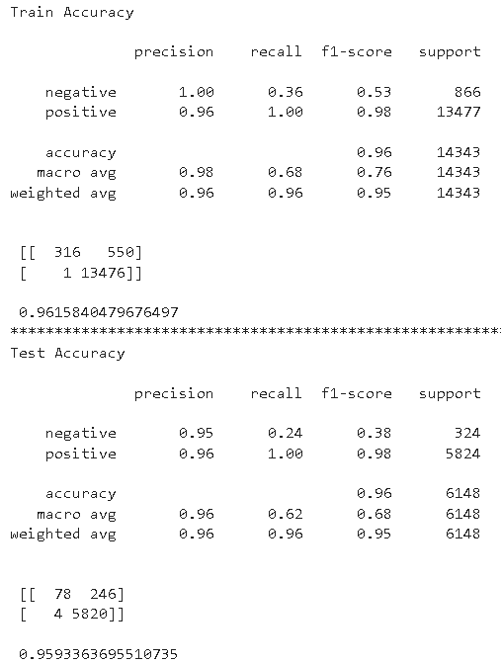
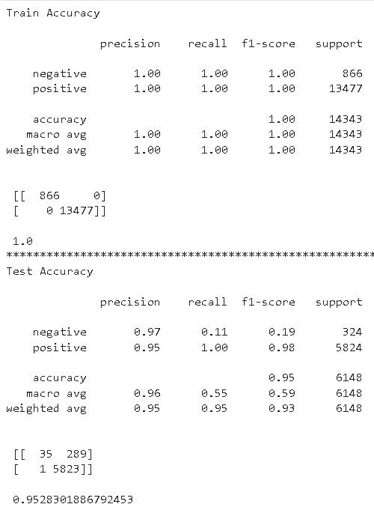
1.Logistic Regression:
Accuracy of train dataset is 0.961
Accuracy of test dataset is 0.959
2.Random Forest Classifier:
Accuracy of train dataset is 1.0
Accuracy of test dataset is 0.95

Slide 32
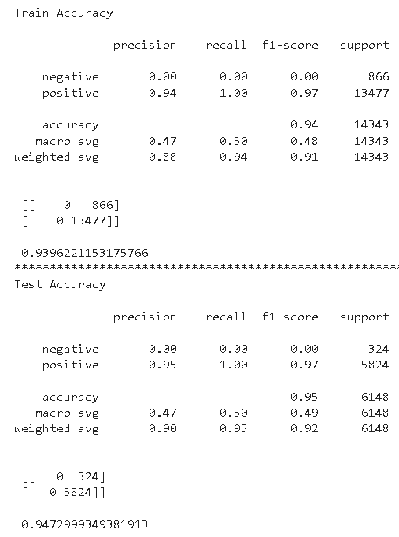
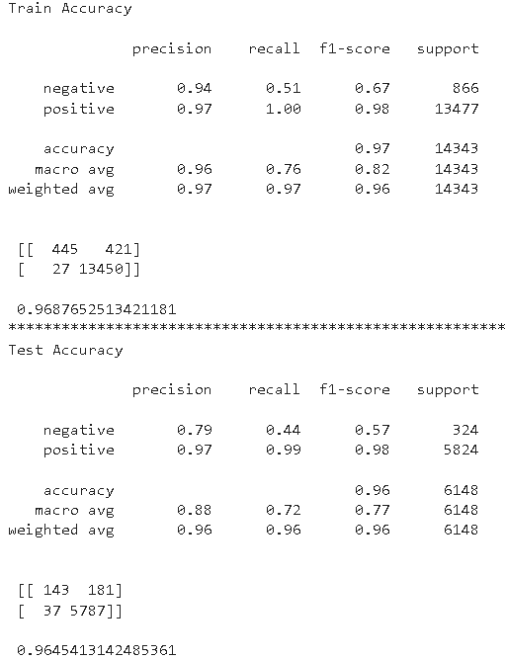
3.Naivebayes:
Accuracy of train dataset is 0.939
Accuracy of test dataset is 0.947
4.Gradient Boosting Classifier:
Accuracy of train dataset is 0.968
Accuracy of test dataset is 0.964

Slide 33
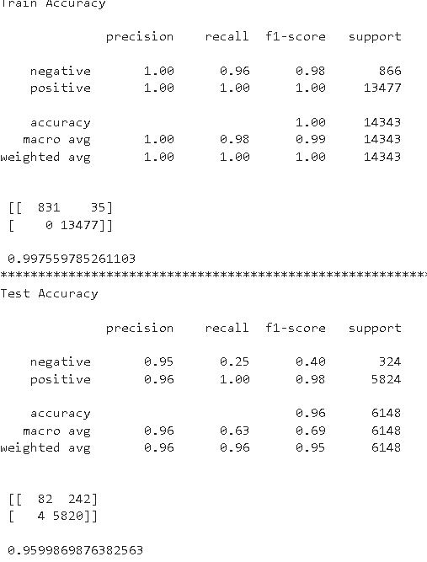
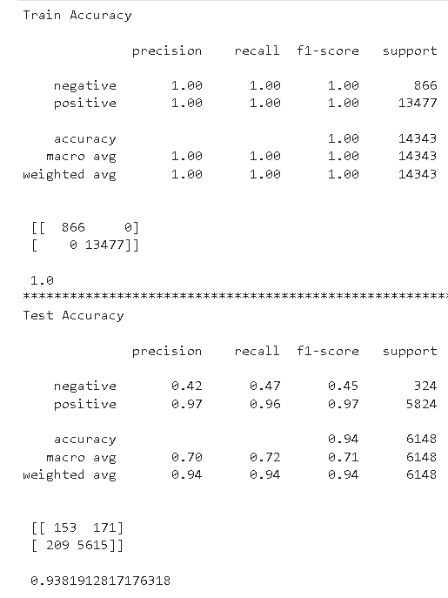
5.SVM:
Accuracy of train dataset is 0.997
Accuracy of test dataset is 0.959
6.Decision Tree:
Accuracy of train dataset is 1.0
Accuracy of test dataset is 0.938

Slide 34
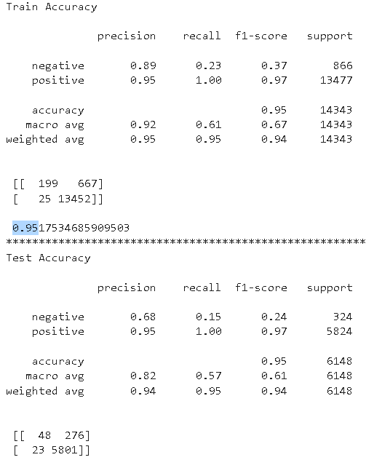
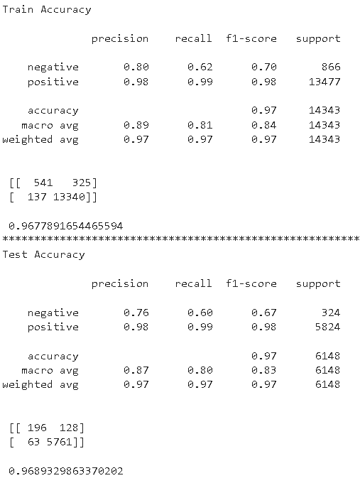
7.K Neighbors Classifier:
Accuracy of train dataset is 0.95
Accuracy of test dataset is 0.95
8.AdaBoost Classifier:
Accuracy of train dataset is 0.967
Accuracy of test dataset is 0.968

Slide 35
Deployment
We chose the SVM model for final analysis
This model was not over-fitting and also predictions of medium rating were better
Deploying from backend to frontend
Deployment Using Streamlit.

Slide 36

Deployment Flow
F R
O
N
T
E
N
D
User Interface Componenet
Enter Review
Get Predicted Ratings
HTTP API SERVICE
B A C K
E N D
Model Training
Model.PKL
Model Prediction

Slide 37
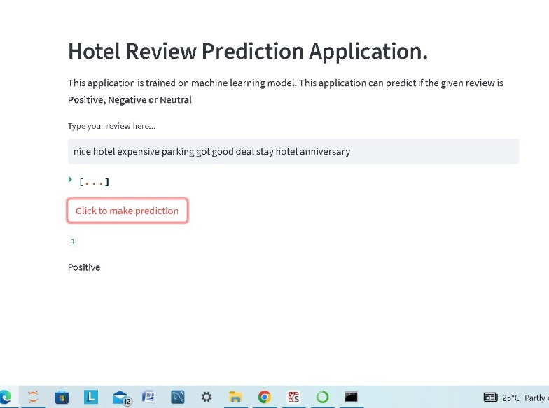
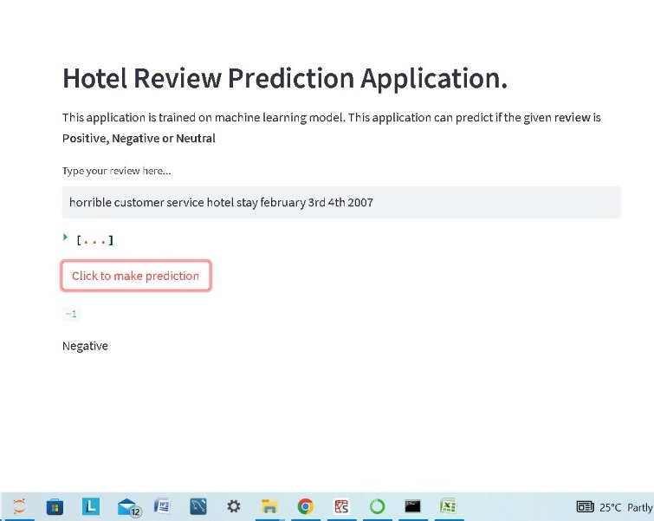
Deployment using streamlit library
Positive Review
Negative Review

Slide 38
Challenges
The data is regarding the Hotel industry, our team has no prior experience of this industry
We browsed the hotel websites, internet, spoke with domain expert to get domain understanding
The data is textual data. Hence converted text to word vectors
Creating a new-list of stopwords that were specific to dataset like hotel, restaurant, room
choosing the model
Ran innumerable models by changing various attributes and parameters
Advanced models were more subjective and hence gave low result scores
But the basic SVM gave better results, hence it was chosen
Though the initial rating level was 5, it gave poor results especially for ratings 2,3,4. Hence combined the ratings to 3 levels. This performed better
This is a classification problem
We ran various classification algorithms to find the best model
Deployment using Streamlit was very new and hence challenging
First understood the Streamlit deployment process and then worked on it

Slide 39
GitHub Links
PAYAL VISHAL KATHAR -
https://github.com/payalk24/Hotel-Rview-Classification-Project.git
PRIYANKA SUNIL MAHULE -
https://github.com/Priyanka-Mahule/Hotel-Reviews
KAVYA M P -
https://github.com/kavyapshety/Hotel-review-classification-2.git
NIDHIN KV -
https://github.com/Nidhinkv70

Slide 40
THANK YOU

